Slide 1
Three Keys to Effective Supervision
By Rita Sever, MA

Slide 2
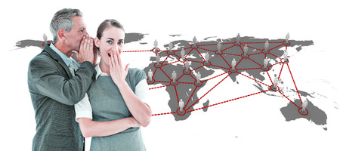
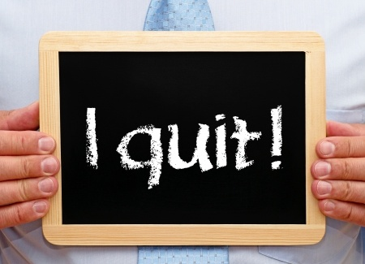
Supervision Matters!
Notes:
These are some of the ways I’ve seen supervision impact orgs: Shaming – good supervisors until something goes wrong
Unbridled gossiping/fragmenting into groups.
High turnover. # 1 reason people leave.
Authoritative top-down management that pushes people to passive or active disengagement

Slide 3
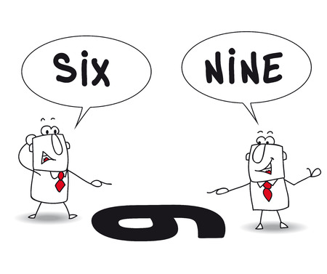
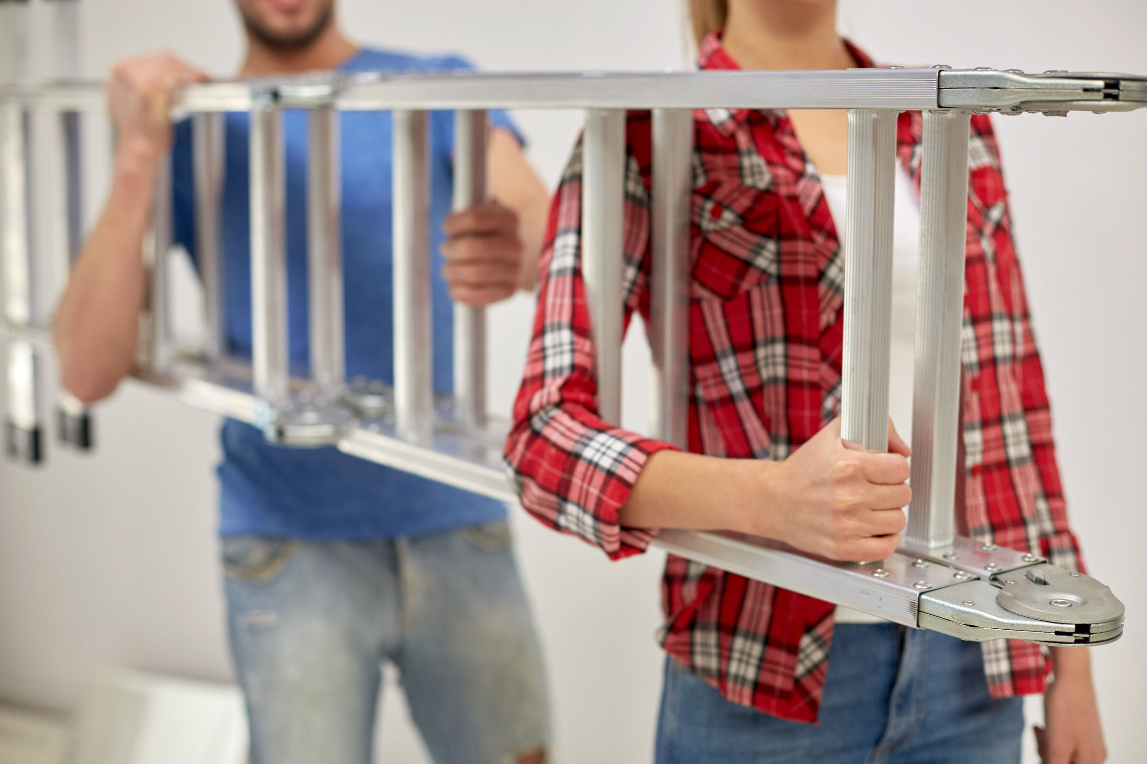
Supervision Matters!
Notes:
These are some of the good ways I’ve seen supervision impact orgs: the good!
6/9 – when supervisors recognize the importance of their own and others perspective and use that awareness to influence their actions as a supervisor;
Team – on the same page and working synergistically together.
Ladder – pulling their own weight. Accountability.
Fun! Joy – Purpose. My thesis.

Slide 4
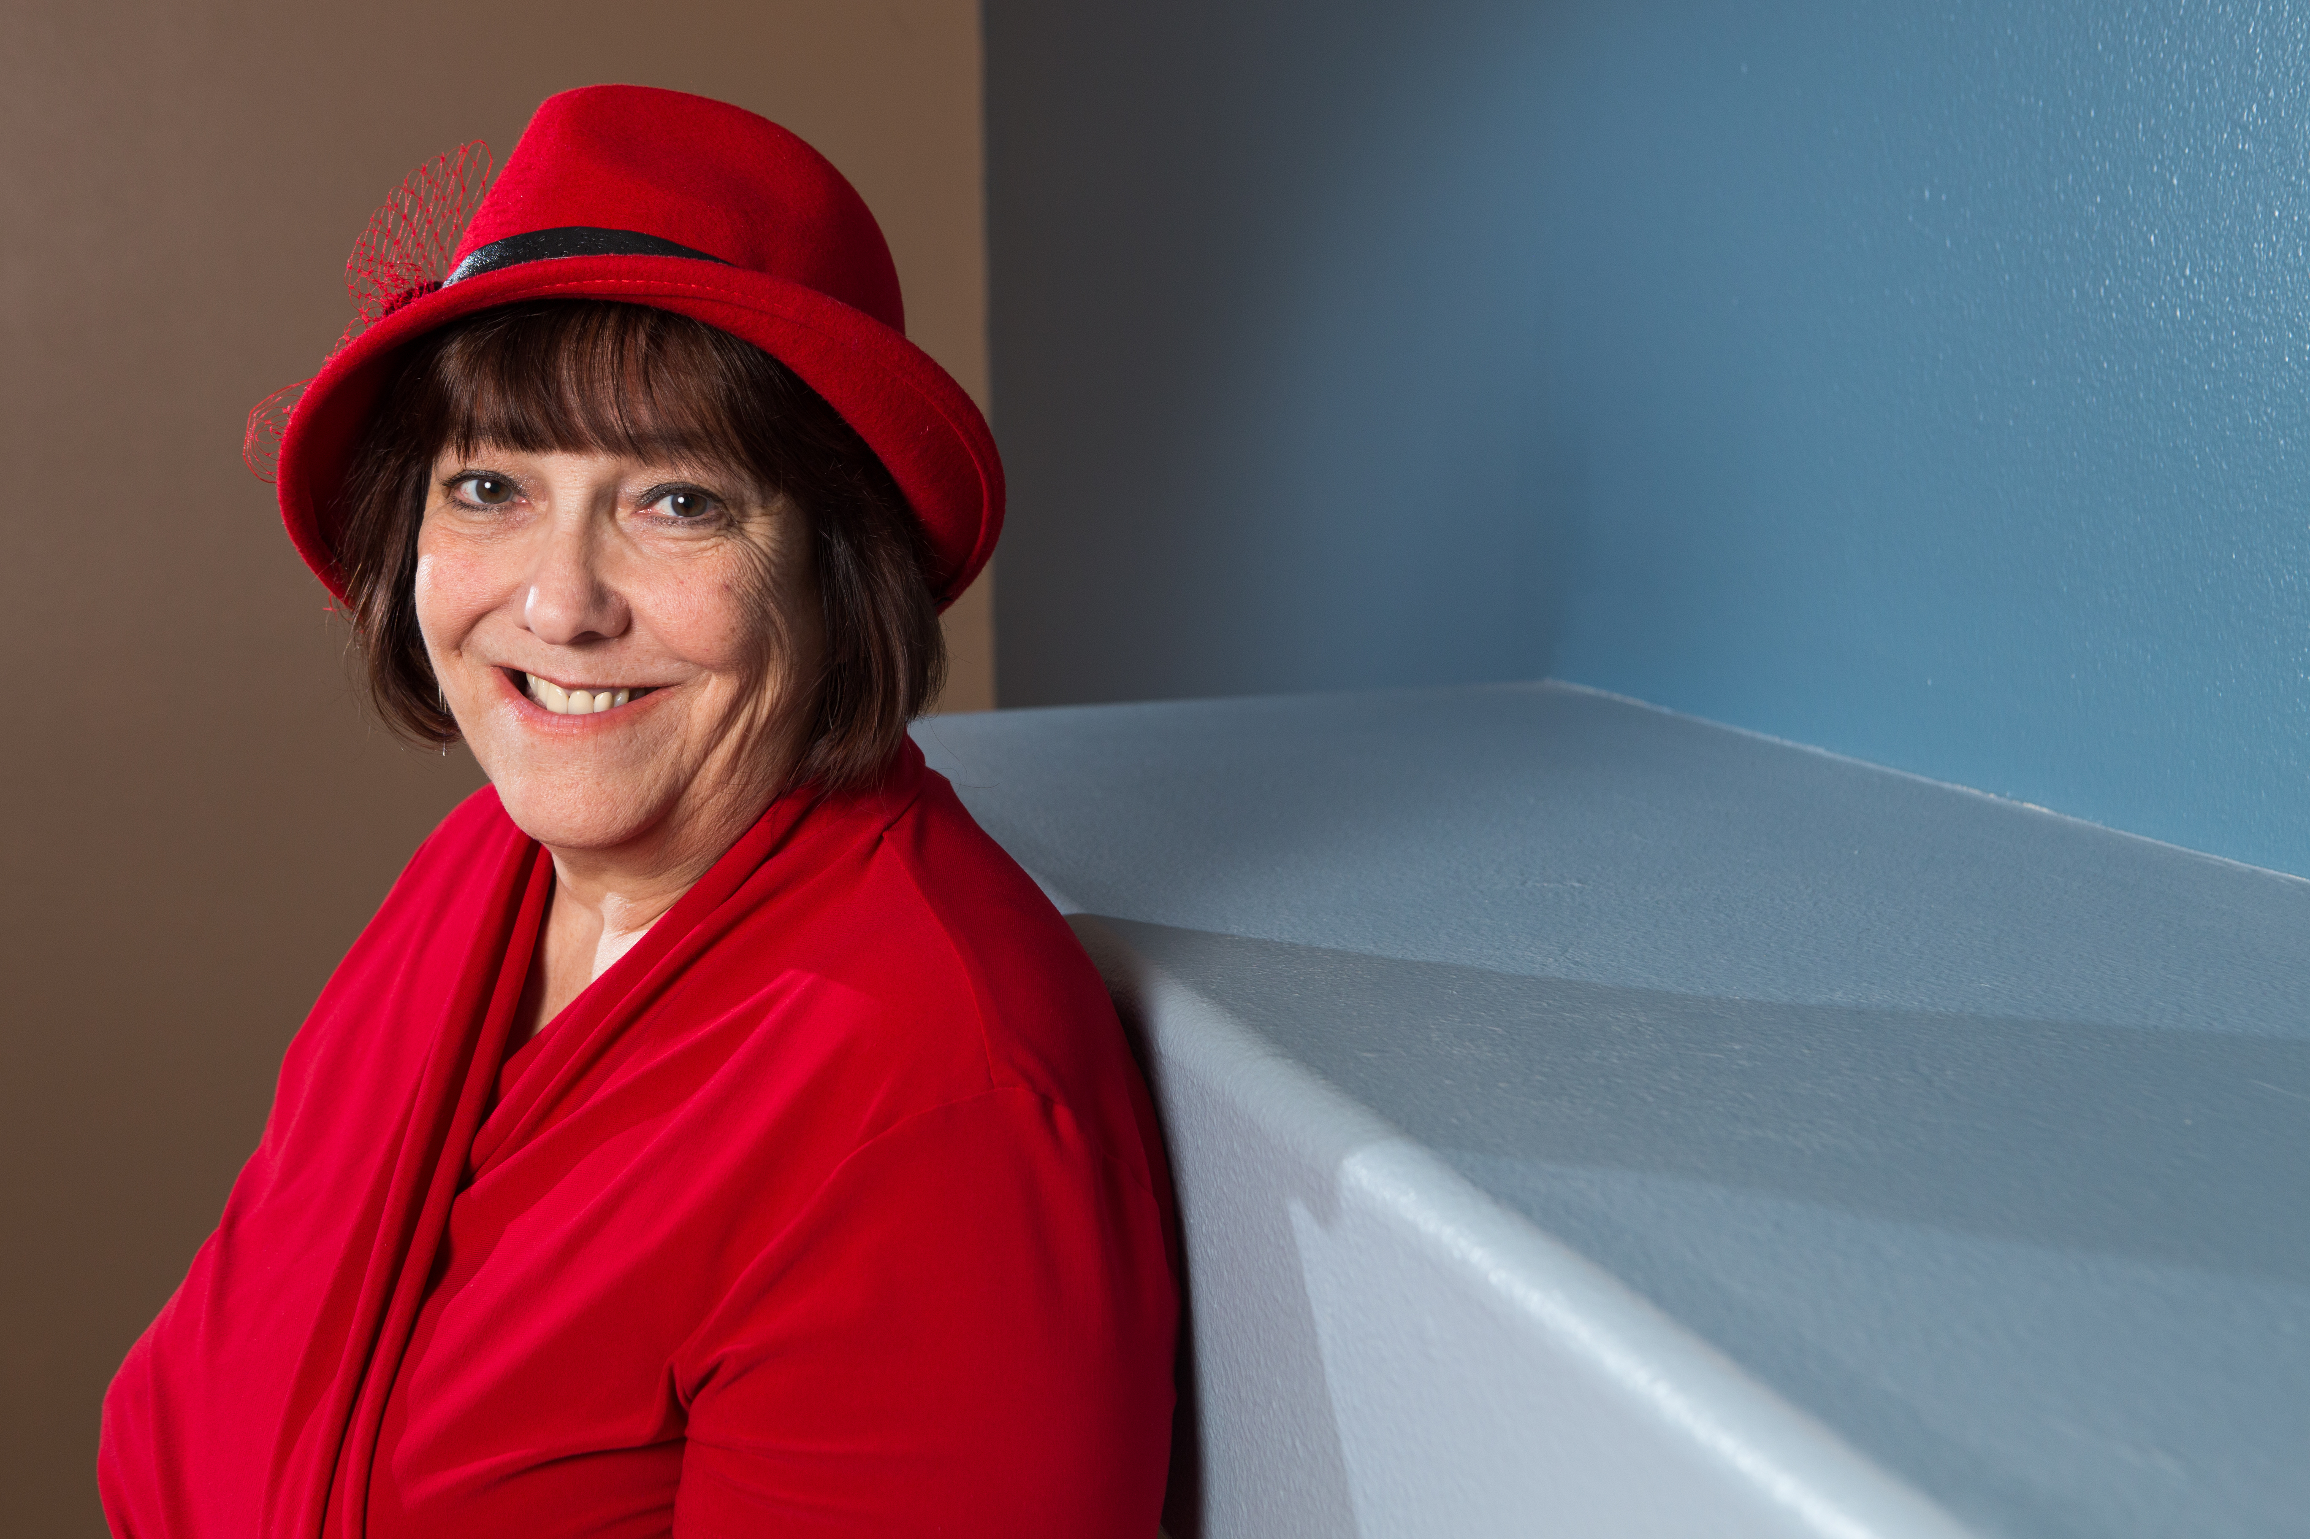
Hello!
I’m Rita
Who’s Here?
Each organization
How many?
Kinds of Jobs?

Slide 5
Hello!
Poll: How many people do you supervise ?
0-1
2-3
4-5
6+

Slide 6
Hello!
What reading was most helpful to you?
Stop Being So Nice
The Transparent Supervisor
Delegation Made Simple
It’s Simply Information
A Formula for Giving Feedback
Look for the Gray
Fair Discipline in Four Steps
Are You A Family or Team

Slide 7
It takes time . . .
Notes:
You can make these happen on your own. Better and strong when an entire organization is aligned in these practices but one supervisor can implement this on her own.
Include awareness of power dynamics.
Trust.
Focus on Mission – every job drawing a line from their work to the mission; talking about it – at orientation and beyond; supervisor reenforcing that . . . Asking them: how did you contribute to our mission this week? Team activities – standing on mission; how your work contributes; the mission is a living thing.
Regular Meetings – 1:1 – the graphic doesn’t actually work – sorry I didn’t catch that! Regular scheduled. Both sides can plan for it. Hear about problems/successes and challenes sooner rather than later. Check on benchmarks. +/-/Next . . .
Success - expectations – Mark’s story – taking time to prepare – what do they need to know? What does success look like? Too often – do this – then – no, that’s not what I wanted!
Clear, prompt, specific, objective feedback; +/-; regular meetings normalize this; Impact on the work. What needs to be different. Facing forward.
Everyone wants to be seen and heard and appreciated. Take time to do that. 1:1 as in feedback but also groups/teams; taking time to celebrate and appreciate; not just looking at the next mountain.
TRUST

Slide 8
Three Keys
to Effective Supervision
Relationship
Regular Meetings
Intentional Conversations
Trust
Relationship
Feedback
Expectations
Expectations
Explicit Clarity
Tasks, Responsibilities and Values
Review when there are changes or problems Make Clear Agreements
Feedback
Honest
Specific
Timely
Positive and Negative
Notes:
You can make these happen on your own. Better and strong when an entire organization is aligned in these practices but one supervisor can implement this on her own.
Include awareness of power dynamics.
Trust.
Focus on Mission – every job drawing a line from their work to the mission; talking about it – at orientation and beyond; supervisor reenforcing that . . . Asking them: how did you contribute to our mission this week? Team activities – standing on mission; how your work contributes; the mission is a living thing.
Regular Meetings – 1:1 – the graphic doesn’t actually work – sorry I didn’t catch that! Regular scheduled. Both sides can plan for it. Hear about problems/successes and challenes sooner rather than later. Check on benchmarks. +/-/Next . . .
Success - expectations – Mark’s story – taking time to prepare – what do they need to know? What does success look like? Too often – do this – then – no, that’s not what I wanted!
Clear, prompt, specific, objective feedback; +/-; regular meetings normalize this; Impact on the work. What needs to be different. Facing forward.
Everyone wants to be seen and heard and appreciated. Take time to do that. 1:1 as in feedback but also groups/teams; taking time to celebrate and appreciate; not just looking at the next mountain.
TRUST

Slide 9
Relationship
Regular Meetings
What’s working?
What’s not working?
What’s next?
Two-way conversations
Awareness of one’s own lens
Consideration of power and privilege
Notes:
Takes time and conversation
Timing depends on tenure in position, position itself, needs of the person, . . . Everyone at least monthly.
Regular format
Always two-way conversation
Intentional questions

Slide 10
Relationship
Growing our lens
Notes:
Takes time and conversation
Timing depends on tenure in position, position itself, needs of the person, . . . Everyone at least monthly.
Regular format
Always two-way conversation
Intentional questions

Slide 11
Relationship
Growing our lens
Notes:
Takes time and conversation
Timing depends on tenure in position, position itself, needs of the person, . . . Everyone at least monthly.
Regular format
Always two-way conversation
Intentional questions

Slide 12
Relationship
Growing our lens
Notes:
Takes time and conversation
Timing depends on tenure in position, position itself, needs of the person, . . . Everyone at least monthly.
Regular format
Always two-way conversation
Intentional questions

Slide 13
Relationship
Growing our lens
Notes:
Takes time and conversation
Timing depends on tenure in position, position itself, needs of the person, . . . Everyone at least monthly.
Regular format
Always two-way conversation
Intentional questions

Slide 14
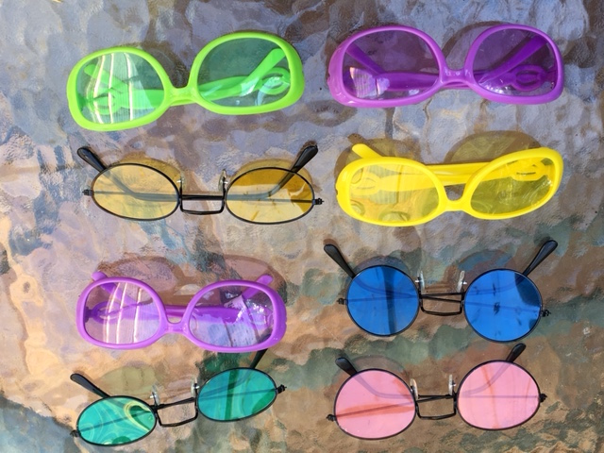
Relationship
Notes:
“We don’t see things the way they are,
we see things the way WE are.”
from the Talmud
“Between what I think I want to say, what I believe I’m saying, what I actually say, what you want to hear, what you believe you heard, and what you understood, there are at least nine possibilities for misunderstanding.
Francois Garagnon
Takes time and conversation
Timing depends on tenure in position, position itself, needs of the person, . . . Everyone at least monthly.
Regular format
Always two-way conversation
Intentional questions

Slide 15
Relationship
REFLECTION:
What contributes to
your lens and how does
that impact your work?
Notes:
Takes time and conversation
Timing depends on tenure in position, position itself, needs of the person, . . . Everyone at least monthly.
Regular format
Always two-way conversation
Intentional questions

Slide 16
Relationship
BACKGROUND | FOREGROUND
Power | Respect
Authority | Appreciation
Privilege | Self-Awareness
Notes:
Takes time and conversation
Timing depends on tenure in position, position itself, needs of the person, . . . Everyone at least monthly.
Regular format
Always two-way conversation
Intentional questions

Slide 17
Relationship
Trust is Essential 1. Owning one’s power, authority and privilege
2. Listening and asking questions
3. Doing What You Say You Will Do
4. Awareness of One’s Lens and Style
5. Apologizing for mistakes
6. Letting go and moving on
7. Not gossiping
8. Telling the truth
9. Getting the facts before deciding
10. Not ignoring problems
Notes:
Timing depends on tenure in position, position itself, needs of the person, . . . Everyone at least monthly.
Regular format
Always two-way conversation
Intentional questions

Slide 18
Relationship
Questions?
Comments?
Concerns?
Notes:
Timing depends on tenure in position, position itself, needs of the person, . . . Everyone at least monthly.
Regular format
Always two-way conversation
Intentional questions

Slide 19
Expectations
Notes:
Assignment samples

Slide 20
Expectations
Notes:
Support story and important lesson

Slide 21
Clear Agreements
CLEAR REQUEST
Who?
What?
When?
Where?
Why?
How?
FOUR POSSIBLE ANSWERS
Yes
No
Maybe
I Don’t Know
Notes:
These are the signs that you can watch for:

Slide 22
Clear Agreements
CLEAR ANSWER
Yes
No
The Loop is Closed
Notes:
These are the signs that you can watch for:

Slide 23
Clear Agreements
UNCLEAR ANSWER
Maybe
I Don’t Know
Open Loop
Notes:
These are the signs that you can watch for:

Slide 24
Clear Agreements
MAKE IT A CLEAR ANSWER
Maybe – What?
I Don’t Know - When?
Close the Loop
“Do we have an agreement?”
Notes:
These are the signs that you can watch for:

Slide 25
Expectations
Mission
Values
Job Description
Assignments
Tasks
Responsibilities
Mistakes
Questions
Authority
Independence
Initiative
Due Date
Benchmarks
Teamwork
Deal-breakers
Your own style
CLARITY
Notes:
Help etc. . . Set them up for success . . . Look for where they could get in trouble
Oakland United – parents coming onto them . . .

Slide 26
Expectations
Poll:
Where could
You use
more clarity?
Mission
Values
Job Description
Assignments
Tasks
Responsibilities
Mistakes
Questions
Hidden Rules
Authority
Independence
Initiative
Due Date
Benchmarks
Teamwork
Deal-breakers
Your own style
Problems to Expect
Notes:
Help etc. . . Set them up for success . . . Look for where they could get in trouble
Oakland United – parents coming onto them . . .
Hidden rules . . .

Slide 27
Expectations
Questions?
Comments?
Concerns?
Notes:
Timing depends on tenure in position, position itself, needs of the person, . . . Everyone at least monthly.
Regular format
Always two-way conversation
Intentional questions

Slide 28
Feedback
Feedback is information about past behavior,
delivered in the present,
which may influence future behavior.
Seashore, Whitfield-Seashore and Weinberg
Notes:
Help etc. . . Set them up for success . . . Look for where they could get in trouble
Oakland United – parents coming onto them . . .

Slide 29
Feedback
What is feedback?
Feedback is information
about past (or present)
behavior . . .
NOT a reminder about expectations
NOT a joint problem solving conversation
NOT comments about “people” in general
or a situation in general
NOT you fixing things
Notes:
Help etc. . . Set them up for success . . . Look for where they could get in trouble
Oakland United – parents coming onto them . . .

Slide 30
Feedback
Give your feedback directly.
Join with them.
Choose the right time and place.
Remember that this is simply information.
Be specific.
Make it about the work.
This is the start of a conversation.
General Advice
Notes:
Help etc. . . Set them up for success . . . Look for where they could get in trouble
Oakland United – parents coming onto them . . .

Slide 31
Feedback
Shaming or blaming
“You” statements
DANGERS!
Generalizations:
always, never, . . .
Interpreting
Lack of self-management!
Irrelevant
Notes:
Help etc. . . Set them up for success . . . Look for where they could get in trouble
Oakland United – parents coming onto them . . .

Slide 32
Feedback
N
O
I
R
Need
Observation
FEEDBACK FORUMULA
Impact
Request
Notes:
Help etc. . . Set them up for success . . . Look for where they could get in trouble
Oakland United – parents coming onto them . . .

Slide 33
Feedback
I know we are both committed to serving the clients.
I heard you deal with that frustrated client in a calm and polite manner while also holding our deadline.
I could tell the client felt heard and respected even though she missed the deadline.
Keep up the good work.
Notes:
Help etc. . . Set them up for success . . . Look for where they could get in trouble
Oakland United – parents coming onto them . . .

Slide 34
Feedback
I know you have a lot to get done in the morning before you get here.
Yesterday you were 10 minutes late and today you’re 20 minutes late.
When you are late, someone else has to fill in at the front desk for you and then their work is behind.
I need you to be here on time.
Notes:
Help etc. . . Set them up for success . . . Look for where they could get in trouble
Oakland United – parents coming onto them . . .

Slide 35
Feedback
I know you have a lot on your plate right now.
In the meeting last week, we agreed that you would get me the numbers for my report by yesterday. I haven’t received them.
Now my report is going to be late because I don’t have the data I need.
I want to know what you will do to prioritize our agreements.
Notes:
Help etc. . . Set them up for success . . . Look for where they could get in trouble
Oakland United – parents coming onto them . . .

Slide 36
Feedback
This work is not good enough.
You keep missing deadlines.
I have to keep nagging you to
get anything done.
You try a few!
You don’t get things done
until the last minute
so it makes it hard
for everyone else on the team.
You do the tasks when I tell you to,
but I want you to own the project.
Notes:
Help etc. . . Set them up for success . . . Look for where they could get in trouble
Oakland United – parents coming onto them . . .

Slide 37
When It Doesn’t Work
Prepared to see it through to termination if necessary?
Is it a matter of can’t or won’t?
If discipline, then 4 components:
What’s the problem
What’s the solution?
When?
Consequence?
Notes:
Help etc. . . Set them up for success . . . Look for where they could get in trouble
Oakland United – parents coming onto them . . .

Slide 38
Feedback
Questions?
Comments?
Concerns?
Notes:
Timing depends on tenure in position, position itself, needs of the person, . . . Everyone at least monthly.
Regular format
Always two-way conversation
Intentional questions

Slide 39
Three Keys
to Effective Supervision
Relationship
Regular Meetings
Intentional Conversations
Trust
Relationship
Feedback
Expectations
Expectations
Explicit Clarity
Tasks, Responsibilities and Values
Review when there are changes or problems Make Clear Agreements
Feedback
Honest
Specific
Timely
Positive and Negative
Notes:
You can make these happen on your own. Better and strong when an entire organization is aligned in these practices but one supervisor can implement this on her own.
Include awareness of power dynamics.
Trust.
Focus on Mission – every job drawing a line from their work to the mission; talking about it – at orientation and beyond; supervisor reenforcing that . . . Asking them: how did you contribute to our mission this week? Team activities – standing on mission; how your work contributes; the mission is a living thing.
Regular Meetings – 1:1 – the graphic doesn’t actually work – sorry I didn’t catch that! Regular scheduled. Both sides can plan for it. Hear about problems/successes and challenes sooner rather than later. Check on benchmarks. +/-/Next . . .
Success - expectations – Mark’s story – taking time to prepare – what do they need to know? What does success look like? Too often – do this – then – no, that’s not what I wanted!
Clear, prompt, specific, objective feedback; +/-; regular meetings normalize this; Impact on the work. What needs to be different. Facing forward.
Everyone wants to be seen and heard and appreciated. Take time to do that. 1:1 as in feedback but also groups/teams; taking time to celebrate and appreciate; not just looking at the next mountain.
TRUST

Slide 40
Thank YOU!
Rita Sever, MA
Supervisionmatters.com
FB: @Supervisioncoach
Twitter: @Supervisionhelp
rita@supervisionmatters.com

